Slide 1
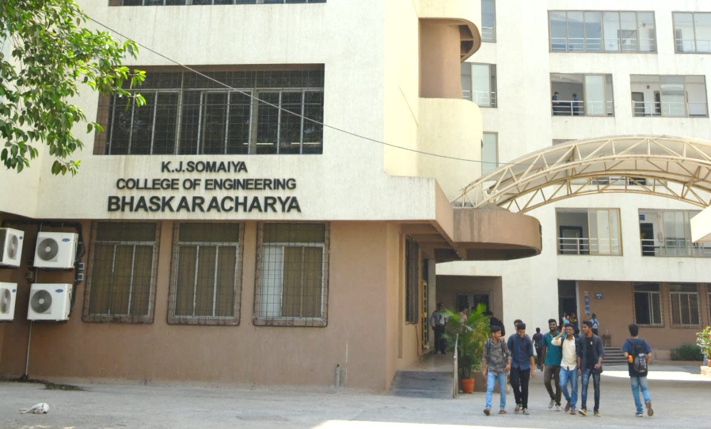
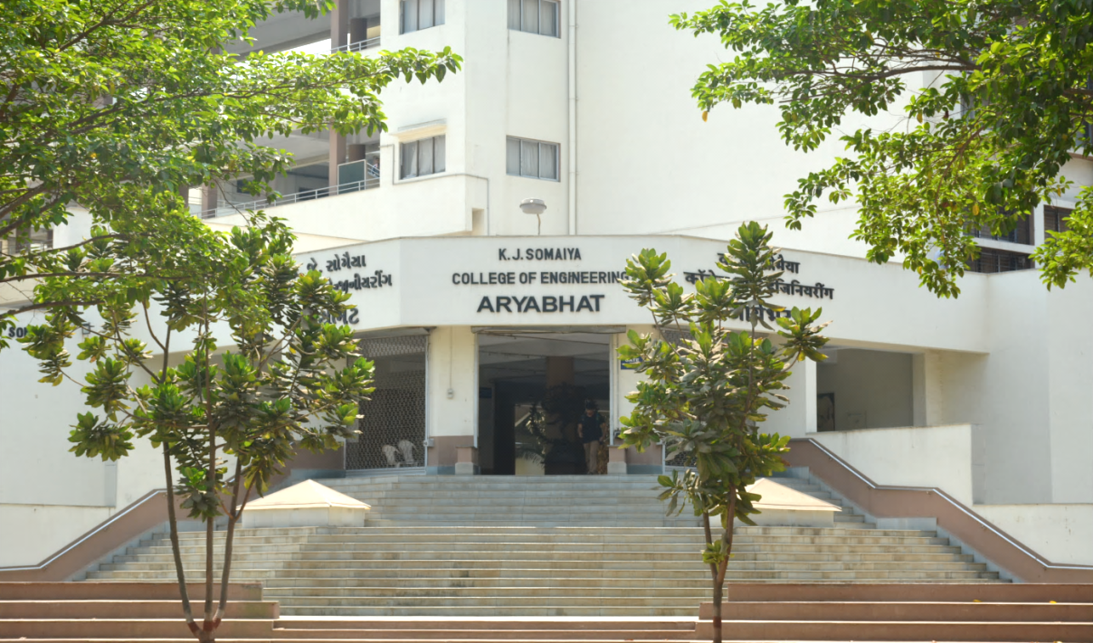
K J Somaiya College of Engineering, Mumbai-77
(Constituent college of Somaiya Vidyavihar University)
Rectilinear Motion

Slide 2
Equation of motion with Uniform Acceleration

Slide 3
The motorist is travelling at 72 km/hr when he observes a traffic light turns red. The traffic light 320 m ahead of him turn red. The traffic light is timed to stay red for 22 sec. If the motorist wish to pass the light without stopping just as it turns green again. Determine: (a) the required uniform deceleration of the car.
(b) the speed of the car as it passes the vehicle

Slide 5
Problem on Motion under Gravitational Acceleration
A ball is thrown vertically upwards along the same path, one from ground with velocity 72 m/s and other from point 120 m above the ground with velocity of 48 m/s. Find when and where they collide? Also find the velocity with which they collide?

Slide 8
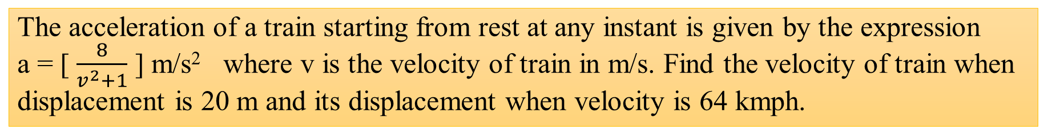
Example on variable acceleration
The acceleration of a train starting from rest at any instant is given by the expression a = [ $\frac{8}{v^{2}+1}$ ] m/s² where v is the velocity of train in m/s. Find the velocity of train when displacement is 20 m and its displacement when velocity is 64 kmph.

